Slide 1
WEEK 6 Neural Networks

Slide 2
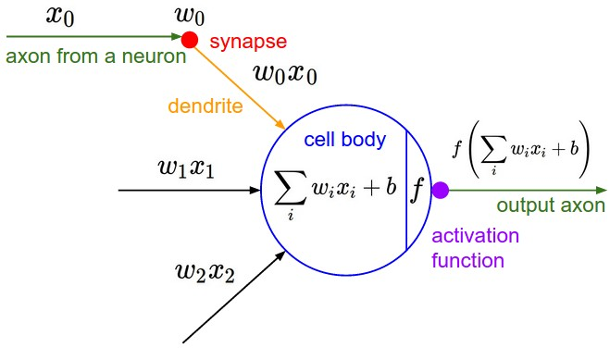
Neuron

Slide 3
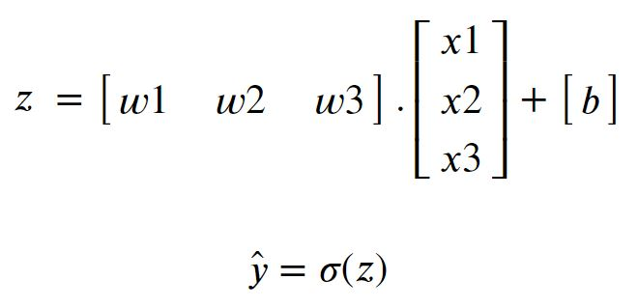
Neuron
x₁
w₁
b
x₂
σ
y
w₂
w₃
x₃

Slide 4
Structure of Neural Networks
b₁^{[1]}
g^{[1]} : activation function of layer 1
g^{[1]}
w_{1,1}^{[1]}
w_{1,1}^{[2]}
x₁
b₁^{[2]}
g^{[1]}
g^{[2]}
y
x₂
w_{3,1}^{[2]}
w_{2,3}^{[1]}
g^{[1]}
b₃^{[1]}

Slide 5
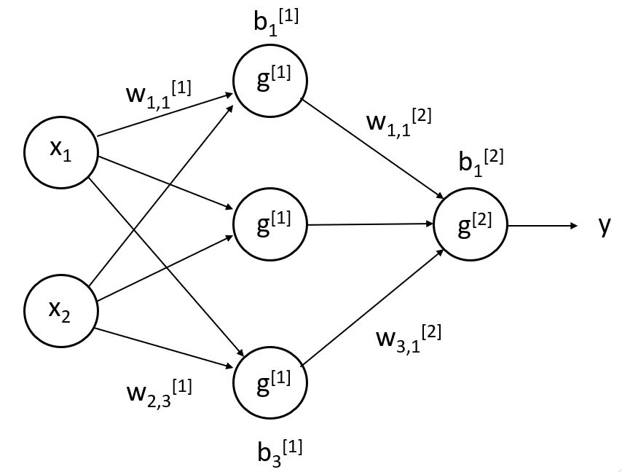
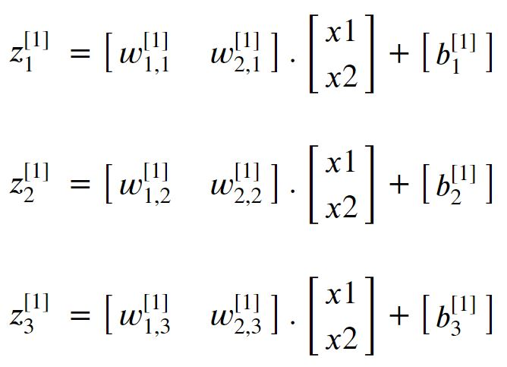
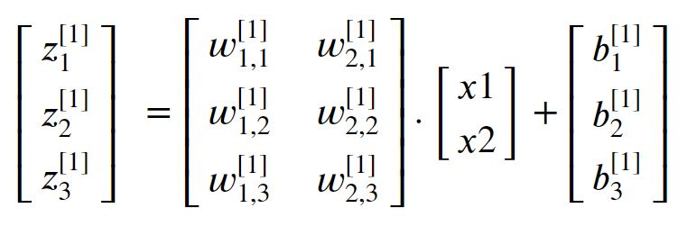
Forward Propagation

Slide 6
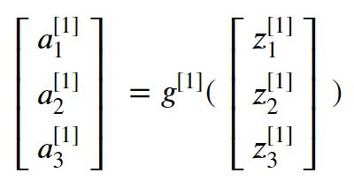
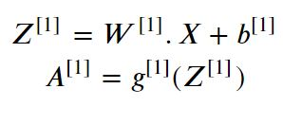
Forward Propagation

Slide 7
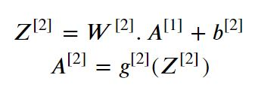
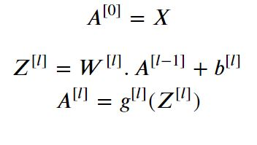
Forward Propagation
Layer 2

Slide 8
Activation Functions
Gives Neural Networks the ability of computing nonlinear functions.
Simulates activation states of real neurons in neural systems.

Slide 9
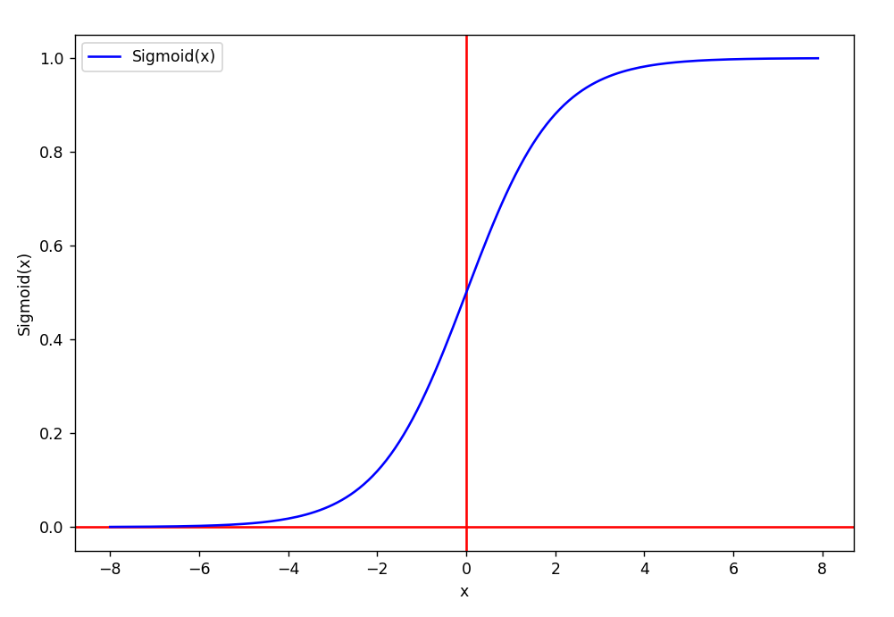
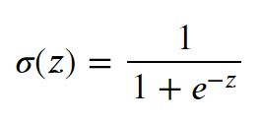

Sigmoid
Derivative of Sigmoid:

Slide 10
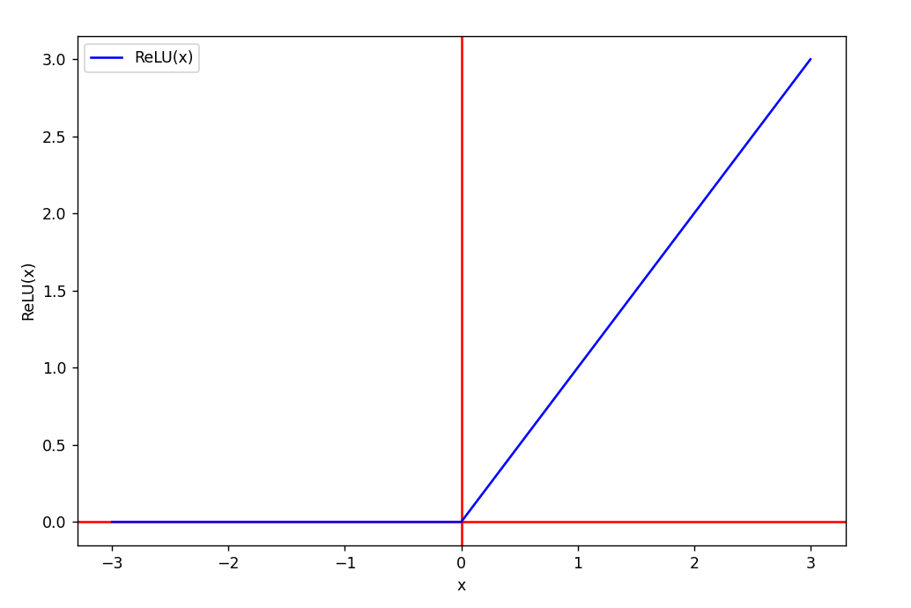
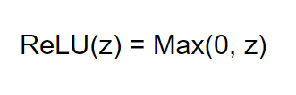
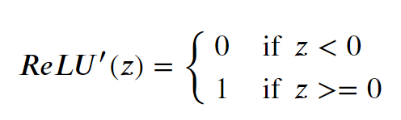
ReLU (Rectified Linear Unit)
Derivative of ReLU:

Slide 11
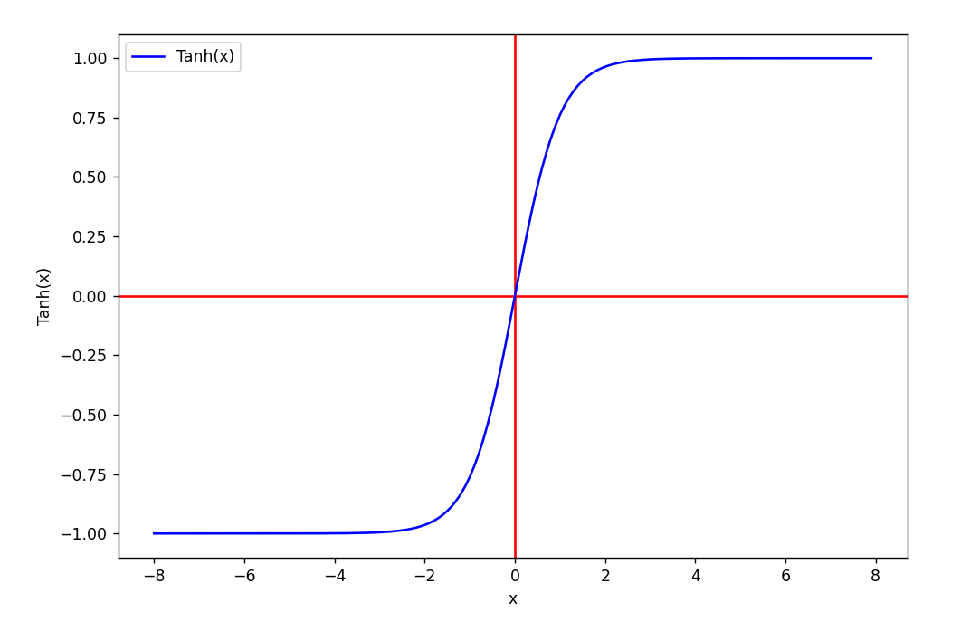
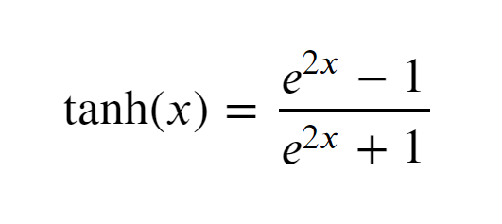
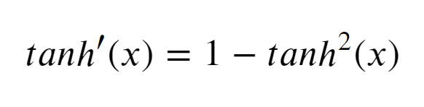
Tanh
Derivative of Tanh:

Slide 12
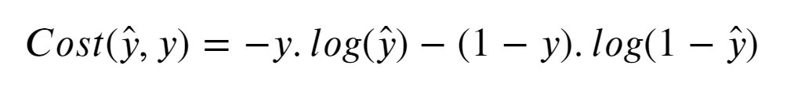
Loss Function

Slide 13
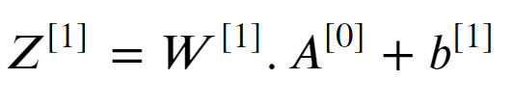
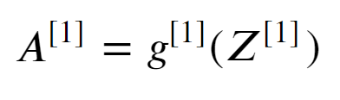
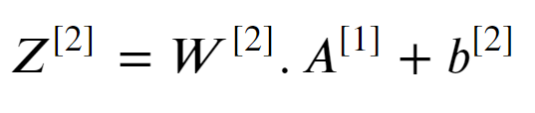
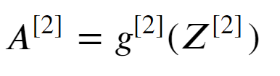
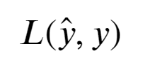
Computation Graph

Slide 14
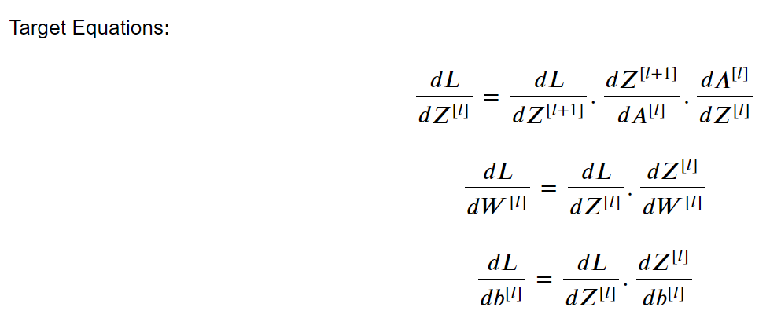
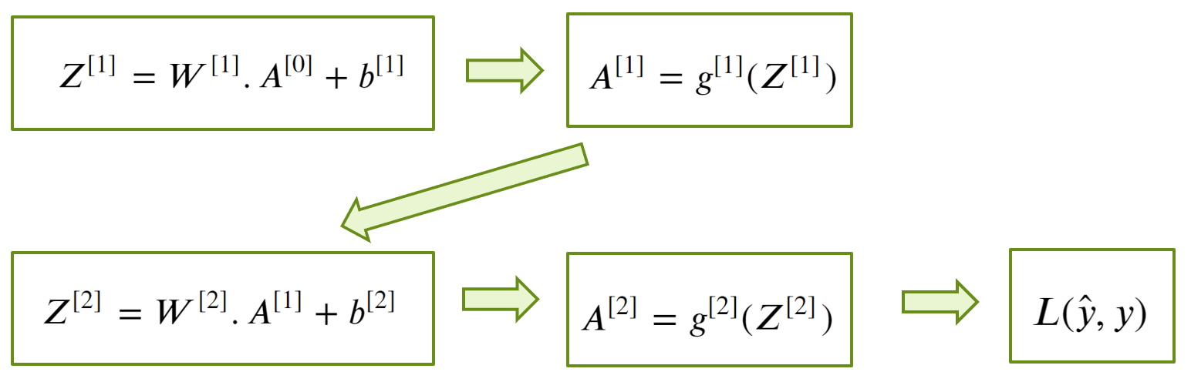
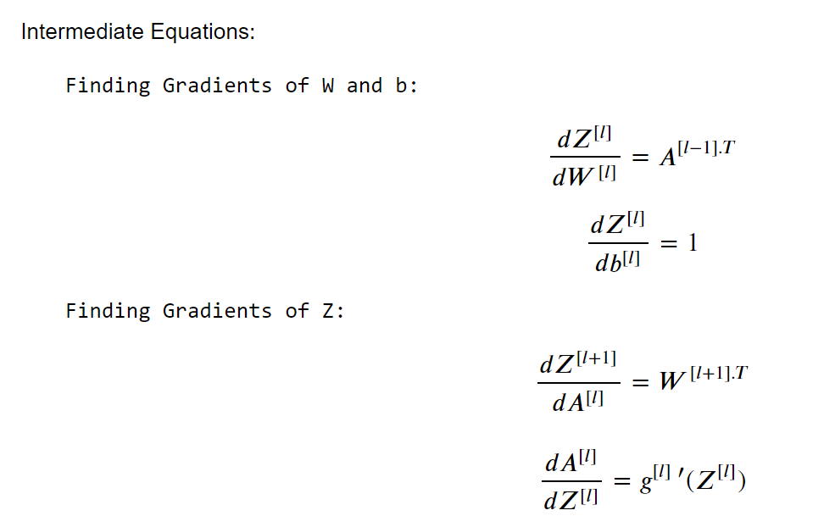
Backpropagation

Slide 15
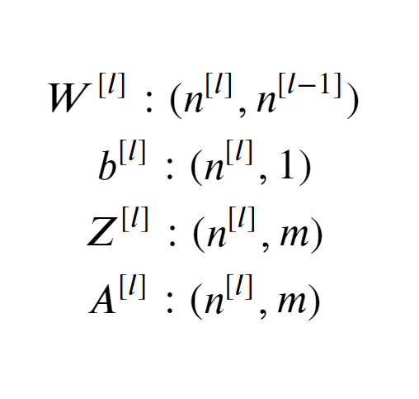
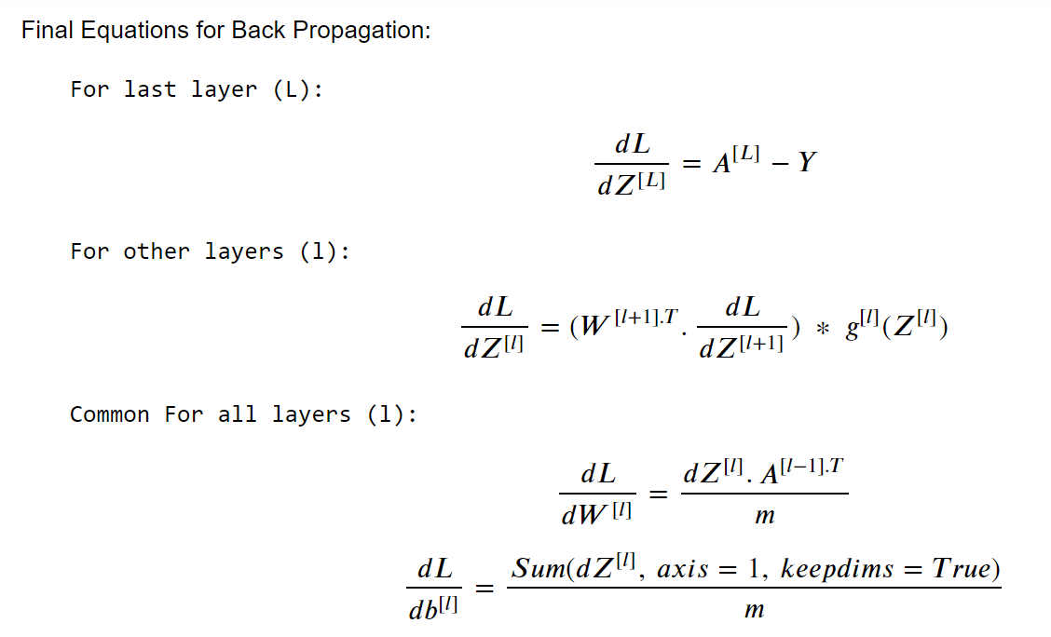
Backpropagation
Shapes:

Slide 16
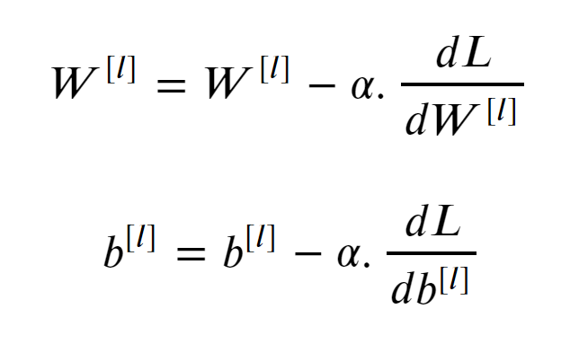
Gradient Descent
For each layer(l):

